Slide 1
Cell-cell communication in the malaria parasite
By Anna Rivkin
MeBop 2017
Bern, Switzerland

Slide 2
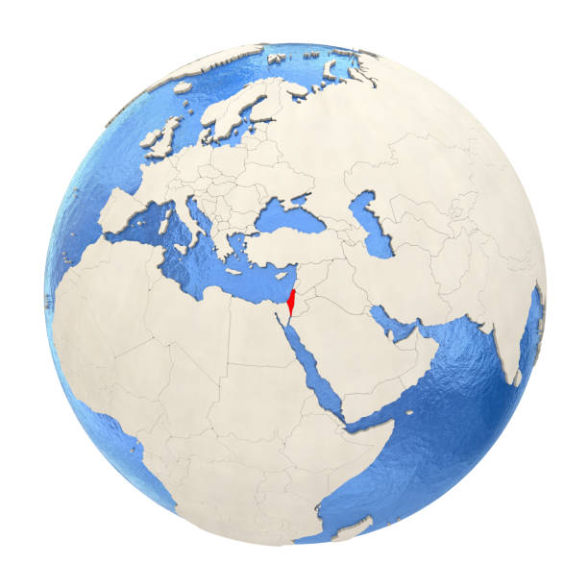

Where?
Israel

Slide 3
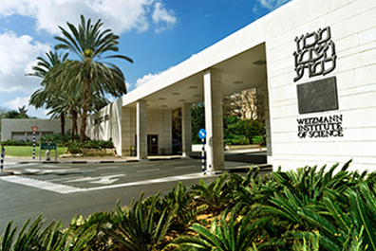
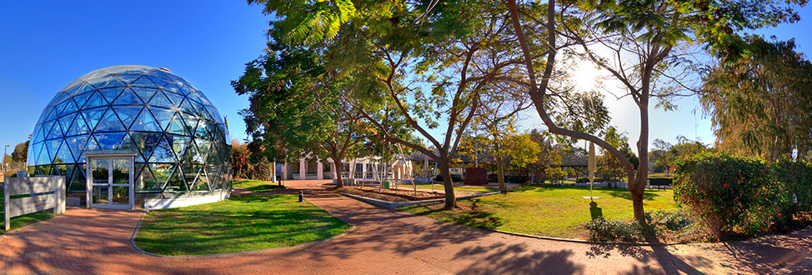
Where?
Israel
Weizmann institute of science
Established in 1934 by Chaim Weizmann
Notes:
First president of Israel.

Slide 4
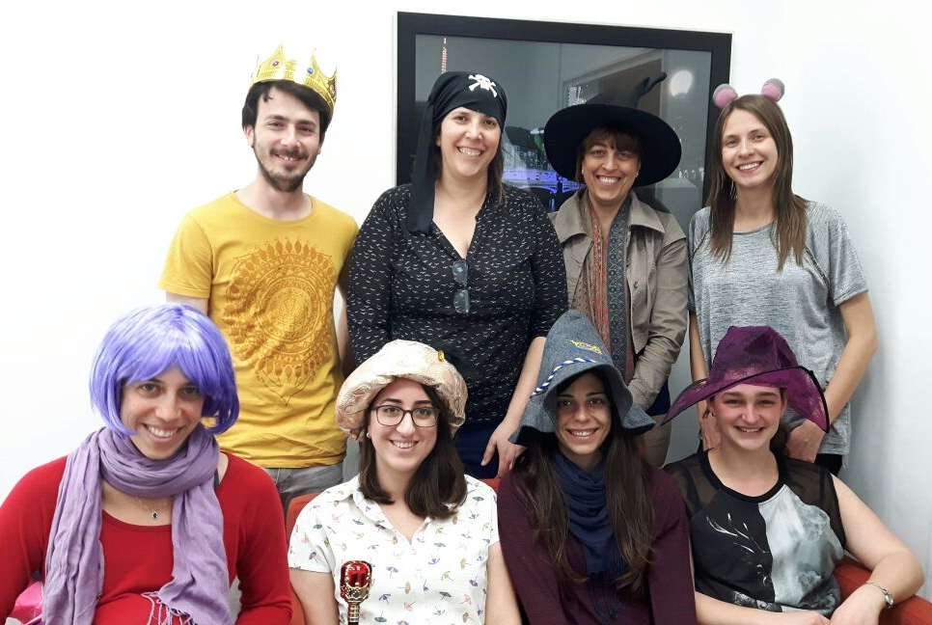
Where?
Israel
Weizmann institute of science
The laboratory of Dr. Neta Regev Rudzki
Gilad
Yifat
Maria
Neta
Einav
Anna
Paula
Sharon

Slide 5
What?
We study cell-cell communication in the malaria parasite

Slide 6
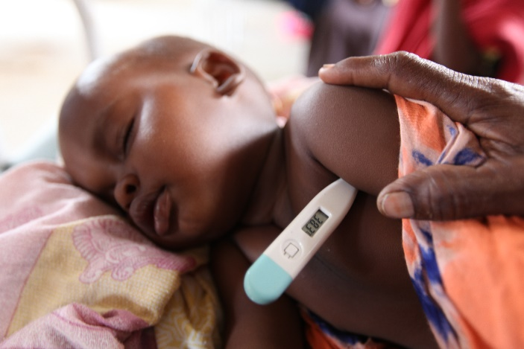
Malaria Disease
One of the most severe health problems worldwide
Affects 3.2 billion people each year
A leading cause of death and disease - 438,000 deaths annually
Most affected groups: young children and pregnant women
UNHCR Photo Gallery, Dadaab, Kenya

Slide 7
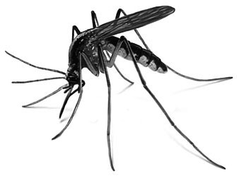
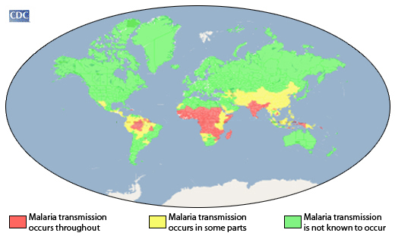
Malaria Disease
A mosquito-borne disease
Caused by the protozoan parasite of the genus Plasmodium
Occurs mostly in tropical and subtropical areas of the world

Slide 8
Malaria Disease
No effective vaccine available
Increasing levels of resistant strains- new drugs needed
Basic research is essential to understand the biology of the parasite

Slide 9
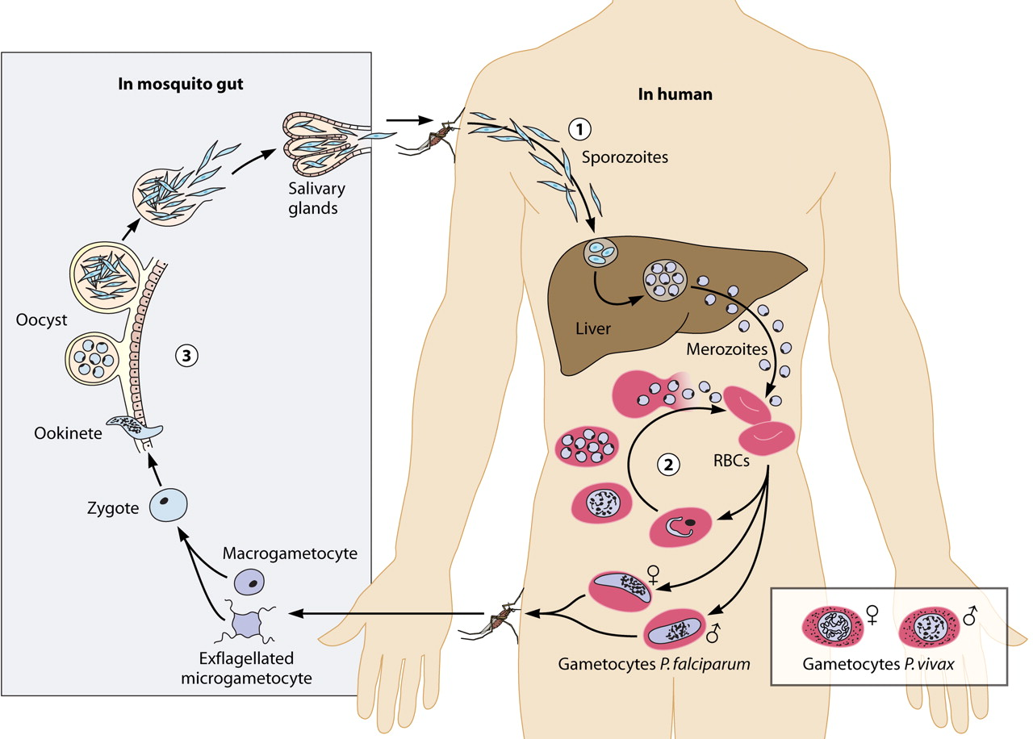
Plasmodium falciparum (Pf)
Complex life cycle - shifts between the mosquito vector and the human host
We grow the parasites in human red blood cells
Bousema & Drakeley, Clin. Microbiol, 2011

Slide 10
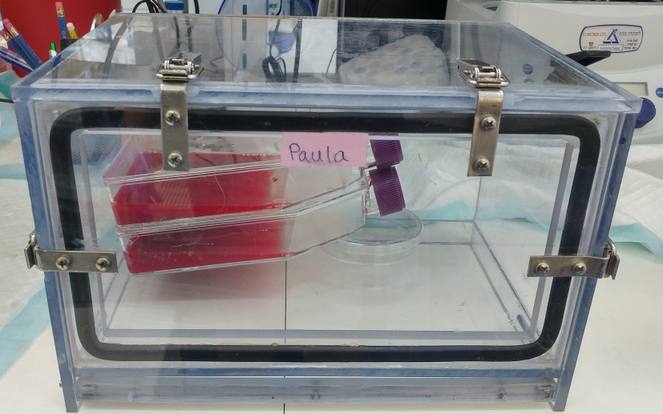
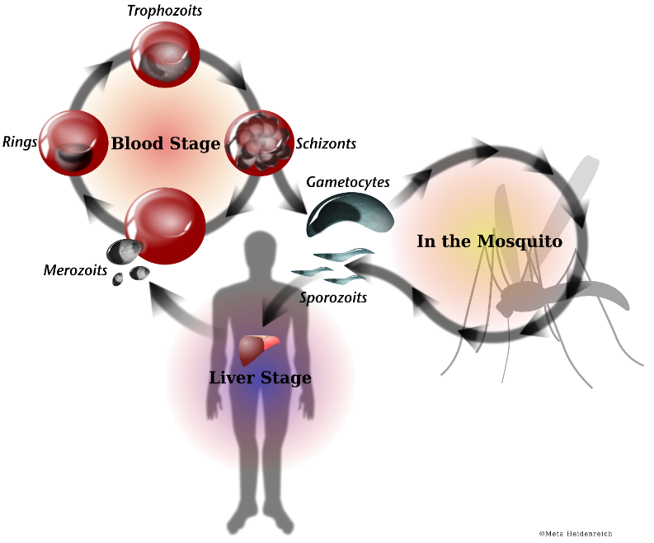
Pf blood stage in-vitro system
Intracellular parasite
Grow Plasmodium falciparum in human red blood cells (RBCs).
Feed them with RPMI media and human RBCs
Grown in special boxes with specific gas mix
Notes:
(5% CO₂, 1% O₂, IN N₂)
Th parasite invade, develop and divide and we can mnitor and detect the parasites inside the red blood cells with microscopy after giemsa staining.

Slide 11
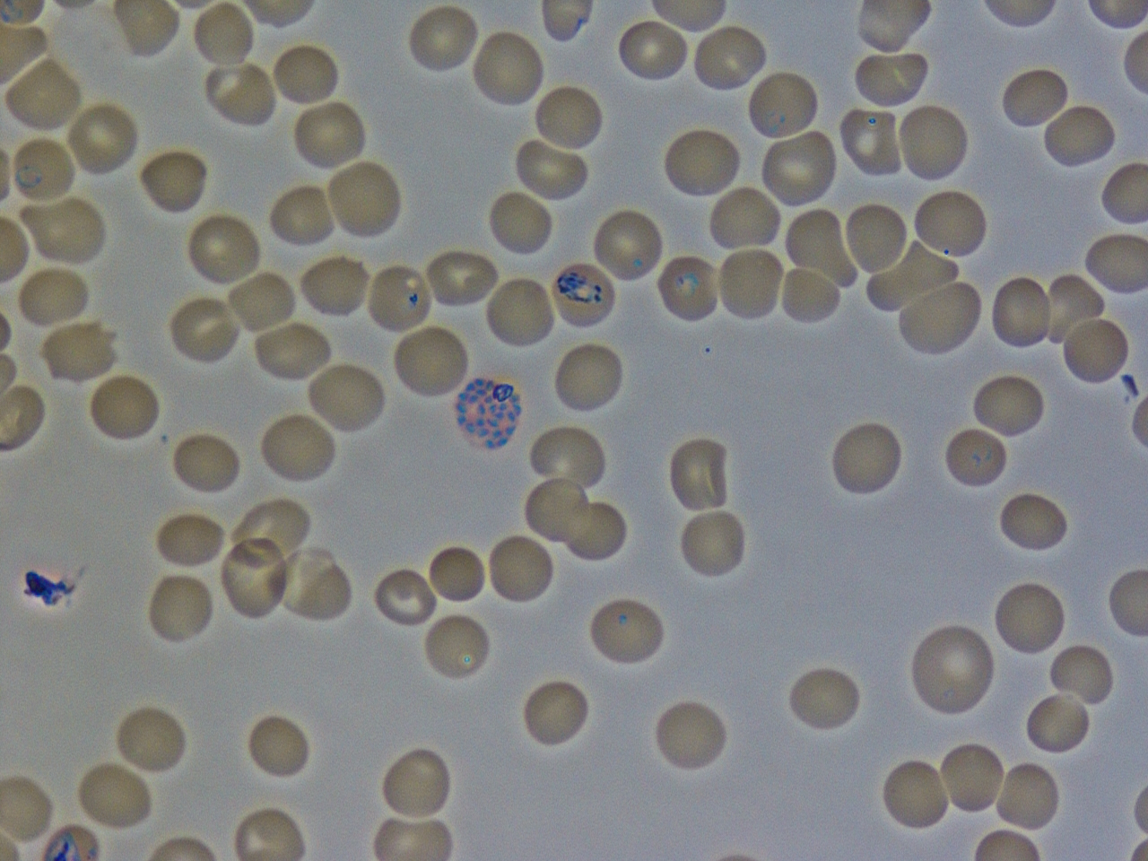
Plasmodium falciparum blood stage
Ring
Trophozoite (early)
Trophozoite (late)
Schizont

Slide 12
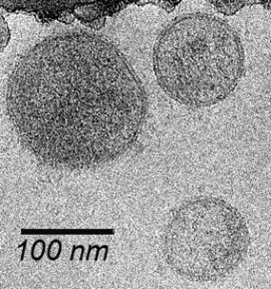
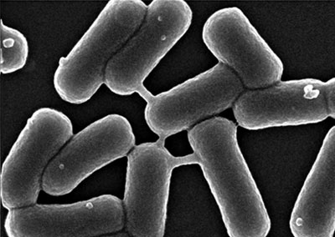
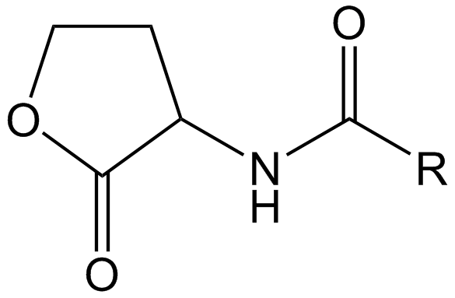
Cell-cell communication
Cell-cell communication and social behavior is established in many eukaryotes and prokaryotes via various mechanisms.
Small molecules Extracellular vesicles Nanotubes
Electron Microscopy platform, CIC bioGUNE
Dubey and Ben-Yehuda, 2011

Slide 13
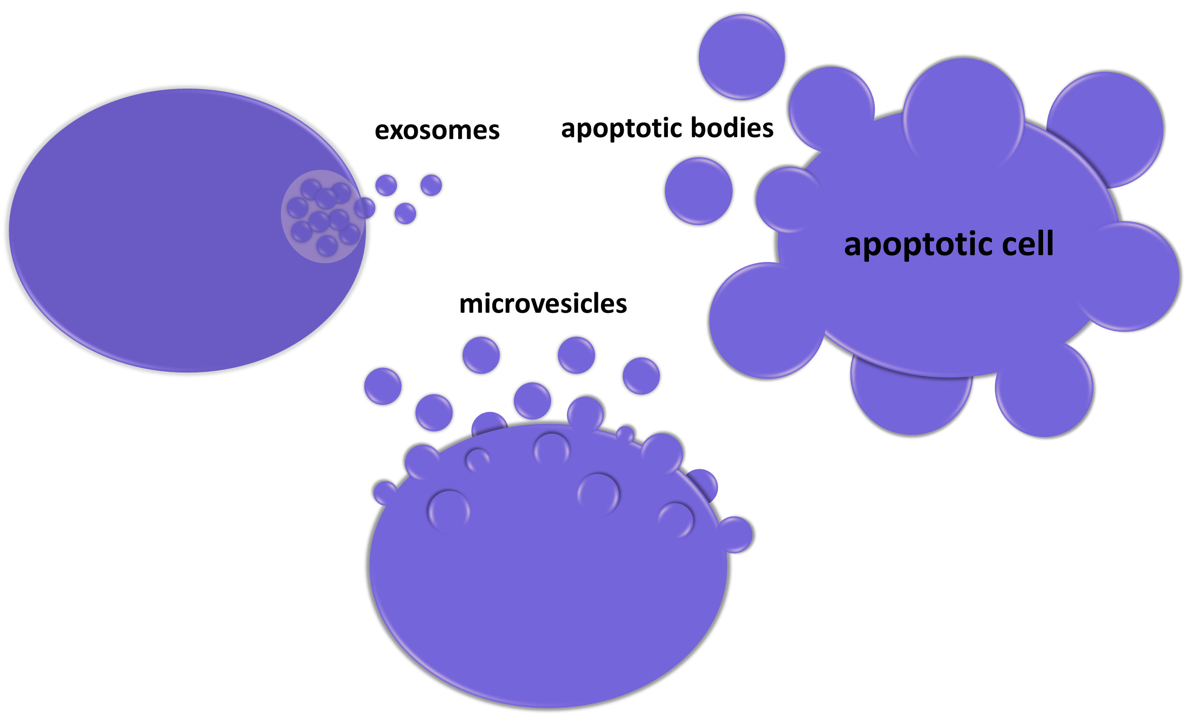
Extracellular vesicles
Membrane-contained, nanometer-sized, vesicles released by cells
Classified into 3 main groups:
a) Microvesicles
b) Exosomes
c) Apoptotic bodies

Slide 14
Cell-Cell Communication in Malaria?
It was recently established PfiRBCs communicate with one another via exosome-like vesicles.
!#)*&^%$#@@#$%^%$
#^$&@!

Slide 15
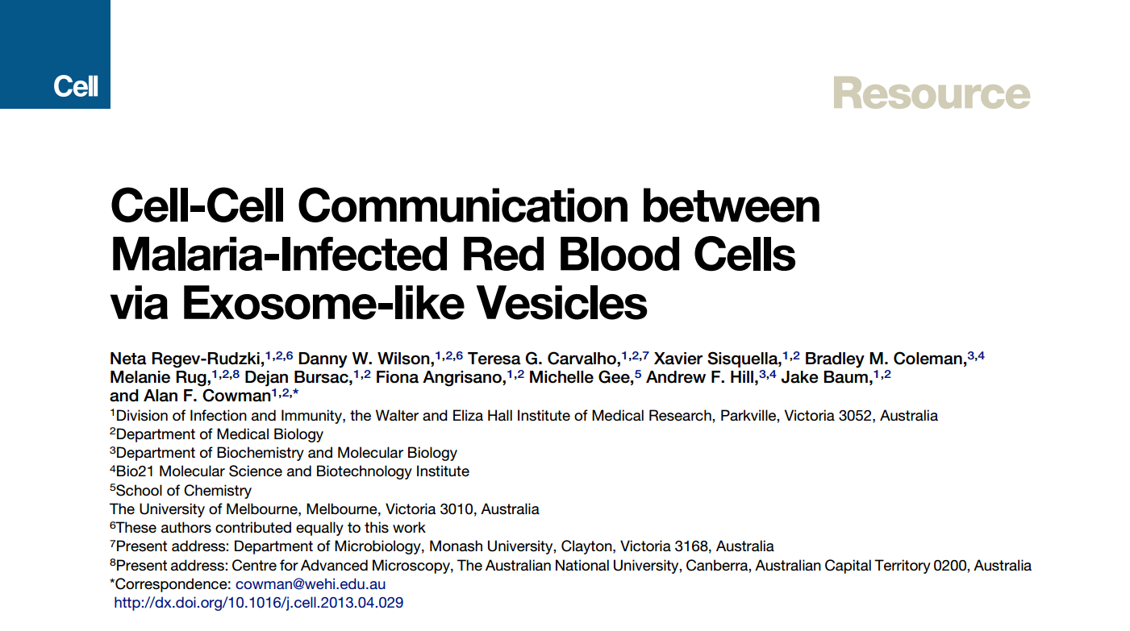
Cell-Cell Communication in Malaria!!!
It was recently established PfiRBCs communicate with one another via exosome-like vesicles.

Slide 16
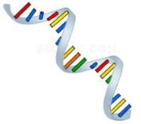
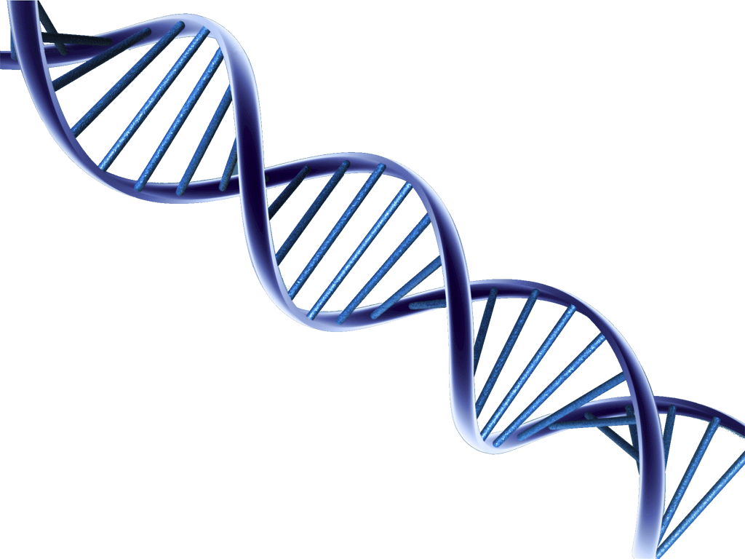
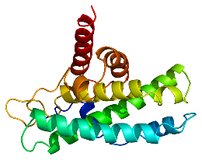
Cell-Cell Communication in Malaria
RNA
DNA
proteins
lipids

Slide 17

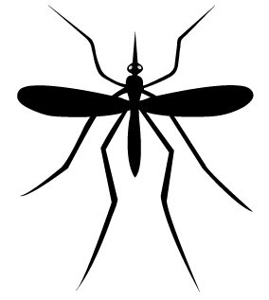
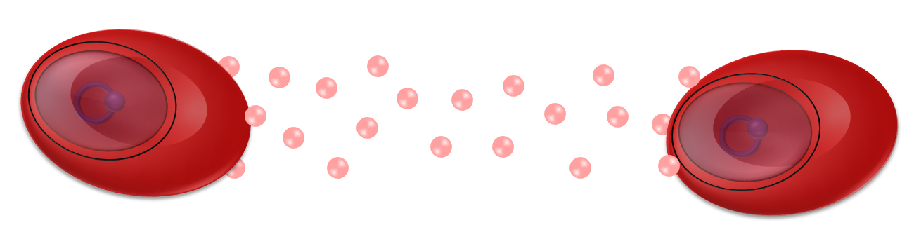
Main research questions
How do infected RBC derived vesicles affect the host cells?

Slide 18
Main research questions
How do infected RBC derived vesicles affect the host cells?
Phospho-proteomics analysis of host THP1 cells (monocyte cell line) revealed unique phosphorylation patterns
Study MAPK pathway in this context.

Slide 19
Unique skills and expertise
Plasmodium culturing
Routine cultures
Growth assays
Biochemistry and molecular assays
RNA, DNA, Protein work
Isolation and characterization of extracellular vesicles
Optiprep / ultracentrifugation
AFM, TEM, nanosight
Vesicle staining
Uptake assays
Vesicle cargo analysis

Slide 20
Difficulties in our local area
Malaria was eradicated from Israel in 1962- No mosquito model available
Only few samples from affected individuals are available

Slide 21
Questions?

Slide 22
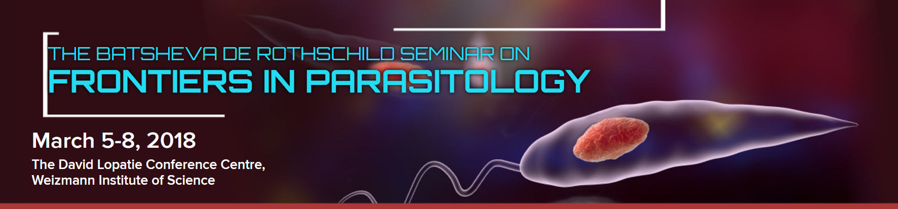
Invitation!
Travel fellowship for students that will fully cover the travel and accommodation of African students are available

Slide 23

Asante!
Thank you!
Merci!
Thank you!
Merci!
Asante!
© 2011 ערברית

